Slide 1
eCommerce
Self Learning – eCommerce
June 2014

Slide 2
Contents
Introduction to eCommerce
Process flow
History and evolution
Key Statistics
Variety of eCommerce business models
Payment gateways
Impact of eCommerce
Threats
Future Trends
Bibliography

Slide 3
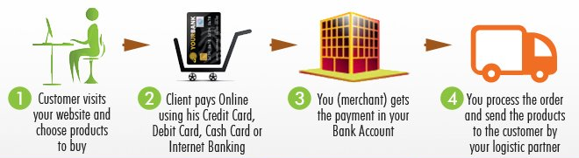
What is eCommerce?
Electronic commerce is the buying and/or selling of products and services through the internet where each transaction involves the transportation of products/services– physical or digital – from one location to another

Slide 4
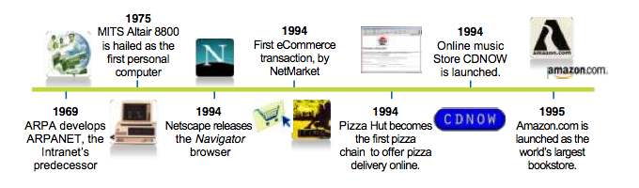
History and Evolution of eCommerce
Development of Infrastructure
eCommerce Boom
eCommerce Pioneers

Slide 5

US is the leading country in eCommerce with 20% market share in 2013
The eCommerce sales forecast for 2013 stood at $1.2 trillion
Total eCommerce sales for US - 2013 estimated at $263.3 billion - an increase of 16.9 percent from the previous year
Average conversion rate of eCommerce sites – 2%
There is steady growth in transactions from mobile platforms with their contribution to total 2013 eCommerce sales being 30%

Slide 6
Contents
Introduction to eCommerce
Process flow
History and evolution
Key Statistics
Variety of eCommerce business models
Payment gateways
Impact of eCommerce
Threats
Future Trends
Bibliography

Slide 7




Variety of eCommerce business models
Parameter | Model A | Model B
Business Model | Consumer-to-consumer platform Company not involved in product procurement & shipping | Direct Retail Company directly responsible for product procurement & shipping
Selling format | Auction price Fixed price | Fixed price
Buyer feedback | Feedback provided is for the sellers | Feedback provided is for the product

Slide 8
eBay(Model A) provides the sellers with a variety of formats for selling their products
Auction-style listing
Sell to the highest bidder or offer
You can list auction-style for 1, 3, 5, 7, or 10 days
Fixed price listing
List items at a set price, so buyers can purchase right away
Sellers can list multiple identical items in one fixed price listing
Selling with a reserve price
(with auctions only)
Selling multiple items
(with fixed listing only)
‘Buy it now’ option lets the buyer purchase the item before the listing's end date
‘Best Offer’ lets the seller choose among buyers who name their highest offer
Classified ads
If sellers wish to sell the item above a min. price, they can create an auction-style listing and a set a reserve price.
The item would be sold only after the highest bid exceeds the reserve price
Seller can advertise on website just as a traditional classified ad.
Seller can state a price, the buyer contacts the seller, and seller handles the transaction personally
If seller often sells the same items, listing them together at a fixed price can improve your standing in search results
Exclusive to Model A
Common to both models

Slide 9
Various teams within eBay are responsible for ensuring smooth operation of their online platform
How to Buy on eBay?
How to Sell on eBay?
Buyer Account Creation
New buyer engagement team
Seller Account Creation
Seller Analytics team
Buyer searches an Item
Seller lists an Item
Buyer finds a required
item
Seller decides on
Time frame
Is it an auction?
Seller decides acceptable
Payment methods
Is it a Fixed listing?
Bids Placed
Is selling
Format an auction?
Buyer Clicks on the
“Buy it Now”
Is selling format
a fixed listing?
Buyer wins
the bid
Wait for the
highest offer
Buyer chooses
a payment method
Seller receives
a payment
Buyer makes
a payment
Shipping Analytics team
Seller ships
the item
Trust Analytics team
Buyer receives the item
& provides feedback
Seller provides
feedback
Note: Other areas of interest include Marketing and Customer Relationship Management(CRM)

Slide 10
Contents
Introduction to eCommerce
Process flow
History and evolution
Key Statistics
Variety of eCommerce business models
Payment gateways
Impact of eCommerce
Threats
Future Trends
Bibliography

Slide 11
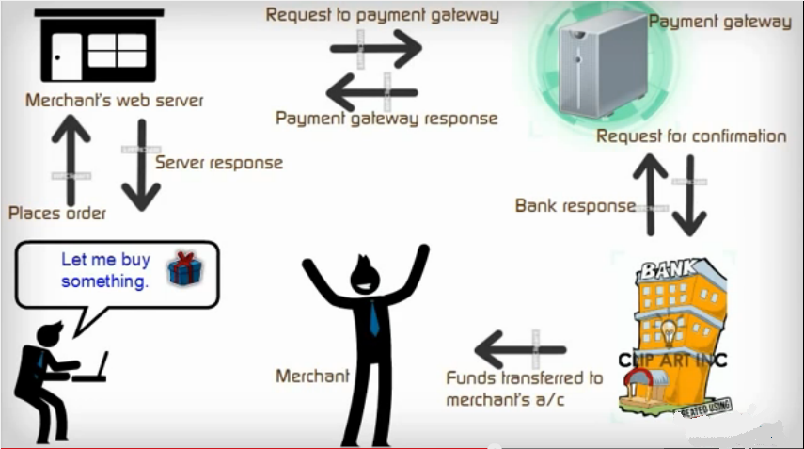
Payment gateways
A payment gateway is an eCommerce application service provider that authorizes payments for online transactions

Slide 12
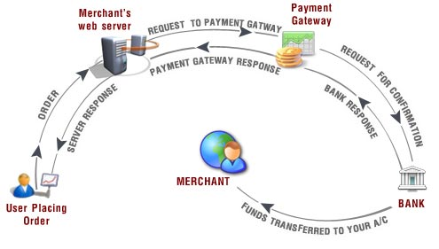
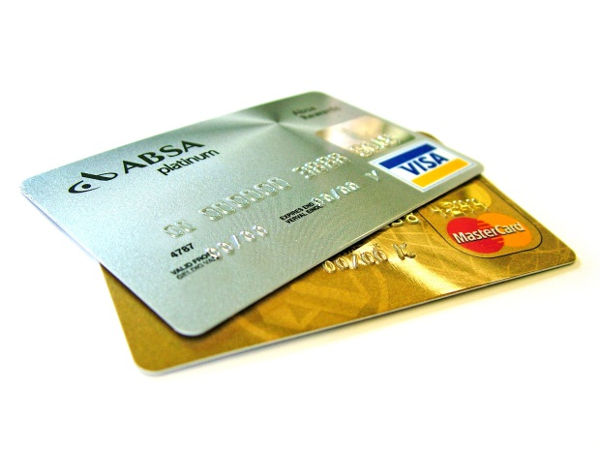

eBay provides capabilities for several payment methods to be accepted by the seller
Buyer wins/buys an item
Buyer chooses a payment option
Buyer needs to pay within 4 days
Payment gateway
Credit Card
Payment on delivery
Buyers pay using their payment gateway account balance
PayPal, a payment gateway acquired by eBay, is the most common mode of online payment where the seller pays a fee on each sale to PayPal
Other payment gateways available for online payment are Propay, Skrill and Paymate
Buyers pay using their credit card by entering their card details
The payment is made online wherein the seller requires an internet merchant account and a payment gateway account
Here the payment is made by the buyer after receiving the delivery of the item from the seller
The seller decides if he wants to provide an option of payment on delivery to the buyer

Slide 13


Pro-Con analysis of Online Payment Gateways
Guaranteed fraud protection mechanism
A few portals can freeze accounts & money
Personal Data Protection
Phishing
Ease of access and usage
Fraudulent transactions due to loopholes in authentication
Multi currency payment processing
High transaction fee for merchants(Payee)

Slide 14
Contents
Introduction to eCommerce
Process flow
History and evolution
Key Statistics
Variety of eCommerce business models
Payment gateways
Impact of eCommerce
Threats
Future Trends
Bibliography

Slide 15





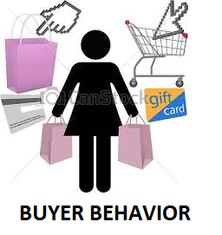
eCommerce has constantly disrupted trends in a wide variety of commercial domains
Positives
Negatives
Reduced overhead expenses
Cannibalization of brick & mortar retail store sales
Expansion of markets and marketing reach
Increase in number of business frauds
Growth of small and medium enterprises and national GDP
Risk of increasing unemployment rate
Increased competition within market can reduce prices
Foreign vendors pose stiff competition to local businesses
Access to a wide variety of products and merchants
Growth in impulsive purchasing due to cash- less transactions
Utilization of feedback to make more informed decisions
Ease of purchase has led to addictions to online shopping

Slide 16



eCommerce platforms need to devise multi-pronged strategy in order to tackle variety of threats
Risks
Phishing – Risk of losing crucial financial information prevents customers from making online transactions
Cyber Security – Customers will avoid those eCommerce portals which are prone to cyber attacks and data breaches
Counterfeit goods –Experiences involving counterfeit products drive away customers from online shopping

Slide 17



Technological Innovation and extensive customization will drive eCommerce in the coming years
Mobile commerce - As phones get smarter, sales activity through this platform is bound to expand significantly. Besides location based marketing, eCommerce platforms are rushing to offer an optimized and seamless shopping experience to mobile users
Personalization – There is increasing focus on leveraging a customer’s browsing history data to generate behavioral insights and personalize search algorithms and marketing strategies for that customer
Technological Collaborations - Amazon has decided to use drones to offer 30-minute deliveries and likewise, in the future many eCommerce players would incorporate technologies to innovate their services

Slide 18
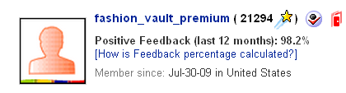




Feedback is an important way to build reputation on eBay as online trading depends on trust
Overall Feedback Score
The positive Feedback percentage
Buyers can leave the DSR’s in the following categories upto 60 days after transaction
Buyers can leave a positive, negative,
or a neutral rating, plus a short comment
Item as described:
How accurate was the item description?
Communication: How satisfied was buyer with the seller's communication?
Buyer
Seller
Shipping & handling charges:
How reasonable were the shipping and handling charges?
Shipping time:
How quickly did the seller ship the item?
Sellers can leave a positive rating
and a short comment

Slide 19
Contents
Introduction to eCommerce
Process flow
History and evolution
Key Statistics
Variety of eCommerce business models
Payment gateways
Impact of eCommerce
Threats
Future Trends
Bibliography

Slide 20
Bibliography
http://www.nngroup.com/articles/conversion-rates/
http://searchenginewatch.com/article/2332195/30-of-Ecommerce-Site-Traffic-Came-from-Mobile-in-2013-Study
http://ecommerze.wordpress.com/2008/06/12/the-history-and-evoltion-of-eCommerce/
http://en.wikipedia.org/wiki/Ebay
http://www.genuineseller.com/comparison-ebay-amazon
http://www.dollarfry.com/worlds-top-10-ecommerce-sites-alexa-rank-basis/
http://www.slideshare.net/paullepa/ecommerce-101
http://www.sleeter.com/blog/2011/12/quickbooks-ecommerce/
http://www.spirecast.com/enabling-technologies-frequently-asked-questions/
http://www.merchant-account-services.org/article/ecommerce-101/11

